Slide 1
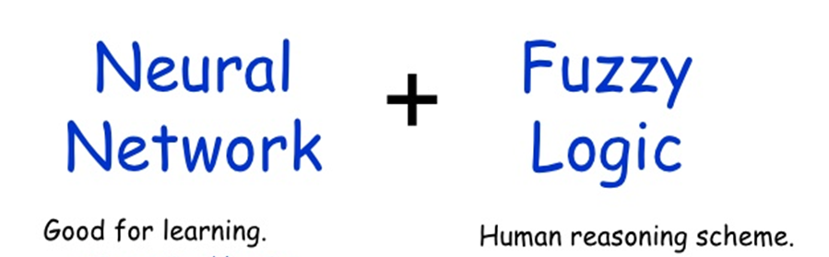
NEURAL NETWORKS
AND
FUZZY LOGIC
(NNFL)
( BITS F312)
JAN-MAY-2020

Slide 2
COURSE CONTENT
Introduction to AI & Intelligent systems
Fundamentals of Artificial Neural Networks (ANNs) & Applications
Fundamentals of Fuzzy Logic & Applications
Hybrid and Evolutionary optimizing techniques

Slide 3


Slide 4
Component | Duration | Marks | Date & Time | Remarks
Midsem Test | 90 Min | 90 | March 2, 2020 2-3:30pm | OB+CB
ASSIGNMENTS –for confidence & accelerating learning pace(90M)
Comprehensive Exam. | 3 hours | 120 | May2,2020(FN) | OB+ CB
Closed book – MCQ/FIB/diagrams/interpretations/explanation
Open Book: design/ analysis. Any book/notes permissible

Slide 5
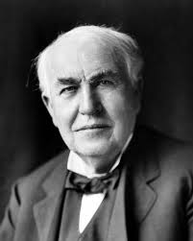
Assignment is an opportunity for SELF-LEARNING
What do you think opportunity
looks like?
Thomas A Edison
"Opportunity is missed by most people because it comes dressed in overalls and looks like work."

Slide 6
ASSIGNMENTS :
1. ONE programming submissions on various topic covered in class/workshops [30 M] Individual
2.Design/Development/Implementation/ Improvisation of research paper(s)
around topics in course [50M] Group of 3
1&2 using framework & libraries like (numpy, keras,fastai, PyTorch, and TensorFlow,matplotlib/pandas( best tool available for importing and managing datasets)
3. Quiz based on Research Paper implemented[10M]

Slide 7
Guidelines for group assignemnt:
group should have a common understanding of goals that need to be achieved.
Respect each other’s ideas
Everyone should share the responsibility of the tasks – programming plus documenting
All group members should have complete understanding of the paper/code
In final presentations , make sure everyone gets chance to present his/her contributions/understanding
“I have made ppts” would invite wrath, and no marks. it is not a course to test your skills in making ppts.

Slide 8
Purpose of Assignments :
Learning the skill of Reading, Understanding and Interpreting Research Publications
Learning art of Collecting relevant information and Assimilating knowledge
Learn art of documenting research
Developing critical reasoning skills
Generating creative / innovative ideas
Creativity and imagination, combined with rigor and discipline is the hallmark of an engineering/science student
Learning team spirit, leadership
Learning Time management

Slide 9
TOPICS of research papers reading & implementation:
Fuzzy logic : Theory and applications in household appliances/transportation systems/ Irrigation systems/Financial systems/Industrial systems/Aviation systems/Pattern Recognition systems
ANN : Theory and applications in Medical diagnosis /Modelling/Speech recognition/NLP/ Face recognition /Pattern Recognition /industrial control system
Hybrid + GA/PSO/DE/ optimization Theory and practice : Fuzzy controller, Neuro controller/ Neuro-Fuzzy controller

Slide 10
Purpose of Assignments
Without research, technological advancement and other developments could have remained a fantasy.
Scientific research in particular "helps students develop critical reasoning skills...helpful for any field of higher education..."
Such search or the thinking process is food for the brain, allowing creativity and logic to remain active.

Slide 11
What do research papers offer ?
Some Papers offer new ideas;
Some offer application/implementation of ideas, and show how they work;
Some bring previous ideas together and unite them under a novel framework.
your goal while reading a research paper, is to understand the scientific contributions the authors are making
Read critically
Read creatively
Make notes as you read the paper

Slide 12
STRUCTURE OF A SCIENTIFIC RESEARCH PAPER
Citation –author(s), date, title of article, name of journal, volume, page numbers.
Abstract –brief summary of the work
Introduction and review of literature –Background info on the field and related previously published research leading up to this
Proposed algorithms/methods/materials –
Findings & discussion –findings in form of charts, tables, graphs, illustrations, photographs
Limitations
Conclusion
References , other work that was cited in the body of the text will show up here

Slide 13
Starting on Research path, HOW to grow to become great researchers ?
Replicate (not just reading the papers) others’ published results build up your foundation of knowledge and gives confidence that you understand the details of the algorithms.
Do not jump too quickly into trying to invent something new
When you’ve read enough papers/blogs/etc. and replicated enough results, almost magically you’ll start to have your own opinions and your own ideas.

Slide 14
When you do build something new, publish it in a paper or blog post and consider open-sourcing your code, and share it with the community to get more feedback from the community, and further accelerate your learning!
Participate in any other enrichment activities that help you learn, such as
online competitions,
going to meetups (community of people with shared goals),
attending (or watching online videos of) good AI/ML/vision/NLP/speech/etc. conferences like CVPR,ICML, NIPS and ICLR.
select a set of your favourite researchers and sign up for notifications on google scholar whenever they publish research papers/blog posts/etc

Slide 15
You can make a lot of progress in learning ML by yourself, but having friends to bounce ideas off will help your learning and also make it more fun.
If you have access to AI experts like professors, PhD students, or good researchers, talk to them too.
Despite the importance of having friends to work with, if your friends disagree with your ideas, sometimes you should still implement it and try it out to see for yourself.
Every world class ML researcher I know has spent a lot of solitary hours implementing algorithms, tuning hyperparameters, reading papers, and figuring out for themselves what does and doesn’t work. I still find this type of work fun, and hope you will too.
Andrew Ng

Slide 16
Books/Reading Materials
There is no single text book..

Slide 17
BOOKS:
Neural Networks and Learning Machines Third Edition Simon Haykin
Neural Networks and Deep Learning Michael Nielsen The original online book can be found at http://neuralnetworksanddeeplearning.com
Artificial Neural Networks,
B Yegnanarayana, (IITM)
Intelligent Systems and Control
Laxmidhar Behera , Indrani Kar (IIT kanpur)
Neural Network Design,Martin D Hagen et al
Machine Learning by Tom M. Mitchell`

Slide 18
A first course in Fuzzy and Neural Control, By Hung T Nguyen et al, Chapman & Hall/CRC Press Company
Wiley India
Fundamentals of Neural networks, architecture, algorithms and applications, Laurene Fausett, Pearson Education
Deep Learning by Yoshua Bengio, Ian Goodfellow and Aaron Courville

Slide 19
Fuzzy Logic with engineering application, Timothy J Ross
Nature-inspired metaheuristc algorithms,
Xin-She Yang
Introduction to Soft Computing , Samir Roy, Udit Chakraborty

Slide 20
INNUMERABLE CONTENT ON INTERNET :
ocw.mit.com, https://ocw.mit.edu/educator/ , nptel via Swayam, coursera,edx, udemy
SLIDES, VIDEO LECTUREs, BLOGS, QUORA, MEDIUM DAILY DIGEST
PDFs of BOOKS

Slide 21
Few very popular courses on internet ..
http://CS229.stanford.edu/ Machine learning
CS224d: Deep Learning for Natural Language Processing
CS224n: Natural Language Processing with Deep Learning
CS231n - Convolutional Neural Networks for Visual
Recognition
all the course material is provided for free
and all the lectures are recorded and uploaded on Youtube.
CMU videos on ML by Prof Mitchell

Slide 22
International Journal of Intelligent Systems from Wiley
IEEE Transactions on Pattern Analysis and Machine Intelligence
IEEE Transactions on Neural Networks and Learning Systems
IEEE Transactions on Computational Intelligence and AI in Games
Look for REVIEW articles in journals of repute by eminent personalities in the field

Slide 23
FEW REPUTED CONFERENCES :
NAACL (North America Association of Computational Linguistics)
CVPR : IEEE Conference on Computer Vision and Pattern Recognition(CVPR)
ICML (International conference on machine Learning)
ICLR (The International Conference on Learning Representations)
AAAI (Association for the Advancement of Artificial Intelligence)
NIPS (Neural Information Processing Systems )
NeurIPS (Neural Information processing System)
IJCAI(International Joint Conference on Artificial Intelligence)
ECCV ( European Conference on Computer Vision)

Slide 24
Eminent personalities Known for their seminal contributions in the field of Machine learning( ML)

Slide 25
Name units in fields of Electricity & Magnetism?
Faraday, Tesla, Weber, Watt, Hertz, Ohm, Ampere, Joules, Gauss, Maxwell,Coulumb, Volt
All named after the scientist who discovered these phenomena in 18th , 19th, early 20th century
In field of AI&ML founders/leaders are alive, young, field is continuously evolving
We know them through their publications/presentations/blogs/
You may also invent a new algorithm/chip which makes AI applications more efficient !

Slide 26
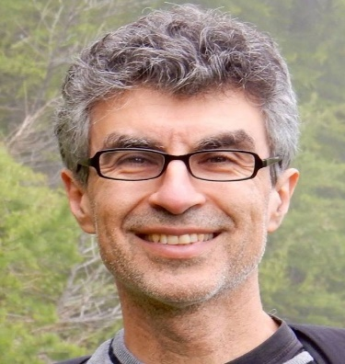
Yoshua Bengio is Full Professor of the Department of Computer Science and Operations Research, Head of the Montreal Institute for Learning Algorithms (MILA)
Famous paper: Learning Deep Architectures for AI
 | Deep Learning, Neural machine translation, Generative Adversarial Networks, Word embeddings, Denoising Auto-Encoders, neural language models, Learning to learn

Slide 27
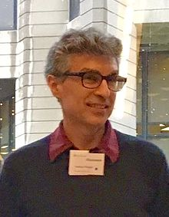
Deep learning involves teaching a machine to perform a complex task using large amounts of data along with a large simulated neural network.
Deep learning is a form of representation learning, where the features of the model are automatically discovered from the data instead of manually constructed, and how to do this is a central problem in machine learning.

Slide 28
Learning Deep Architectures for AI
Yoshua Bengio Dept. IRO, Universit´e de Montr´eal C.P. 6128, Montreal, Qc, H3C 3J7, Canada Yoshua.Bengio@umontreal.ca http://www.iro.umontreal.ca/∼bengioy Technical Report 1312
Deep learning (DL) is a family of machine learning methods that has gained considerable attention in the scientific community, breaking benchmark records in areas such as speech and visual recognition.

Slide 29


Slide 30
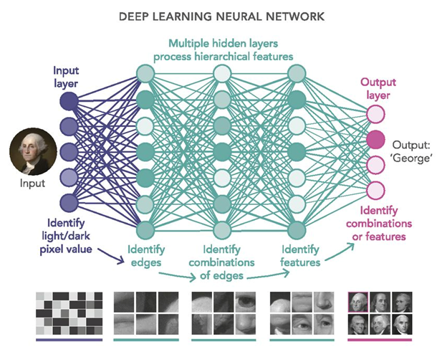

Slide 31
Applications of DL :
Colorization of Black and White Images
Adding Sounds To Silent Movies
Automatic Machine Translation
Object Classification in Photographs
Automatic Handwriting Generation
Character Text Generation
Image Caption Generation
Automatic Game Playing( AlphaGo, AlphaZero etc.)

Slide 32
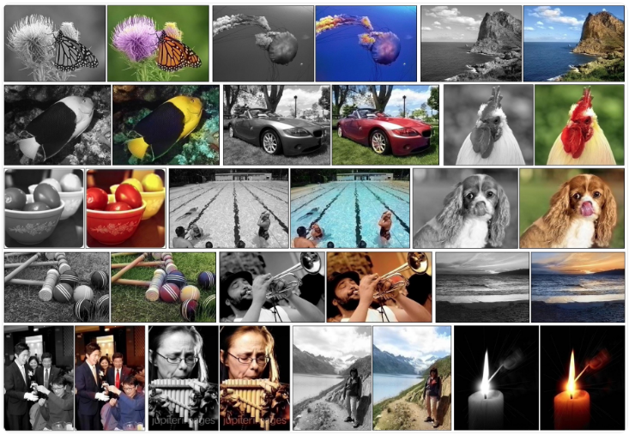


Slide 33
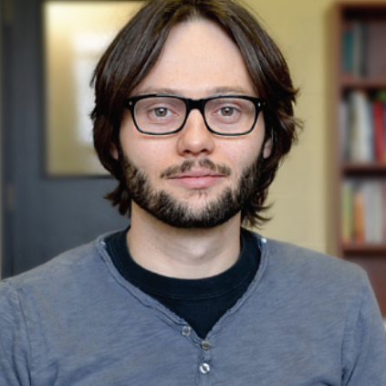
Hugo Larochelle Research Scientist at Google Brain Adjunct Professor Département d'informatique Université de Sherbrooke, Canada
particularly interested in deep neural networks, mostly applied in the context of big data and to artificial intelligence problems such as computer vision and natural language processing.

Slide 34
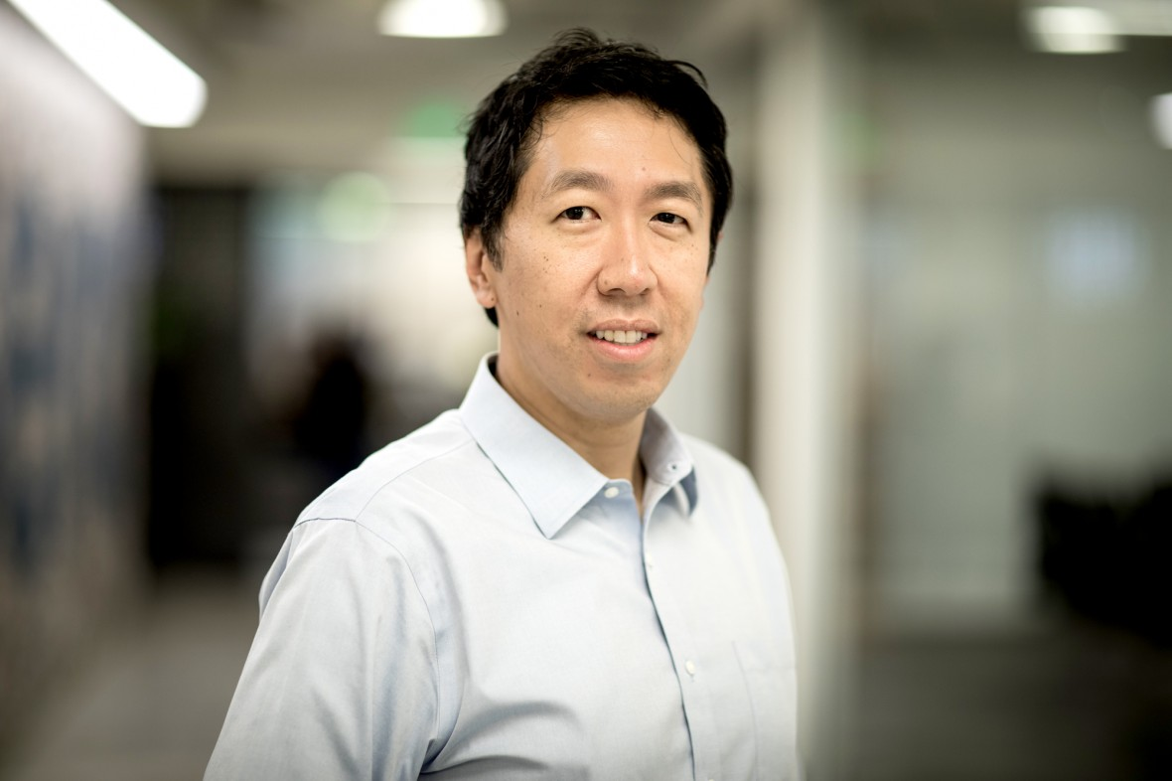
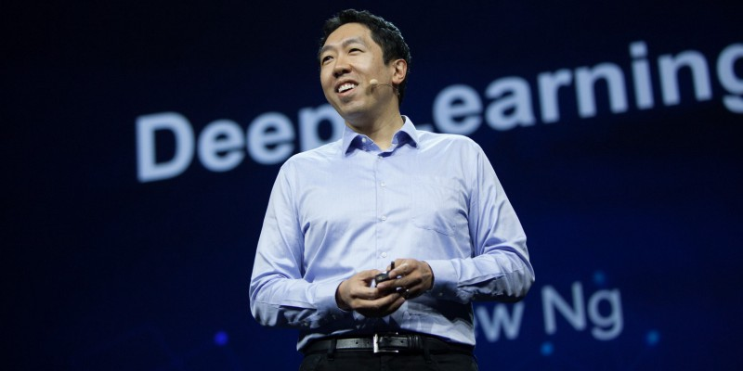
One of the top minds in artificial intelligence

Slide 35
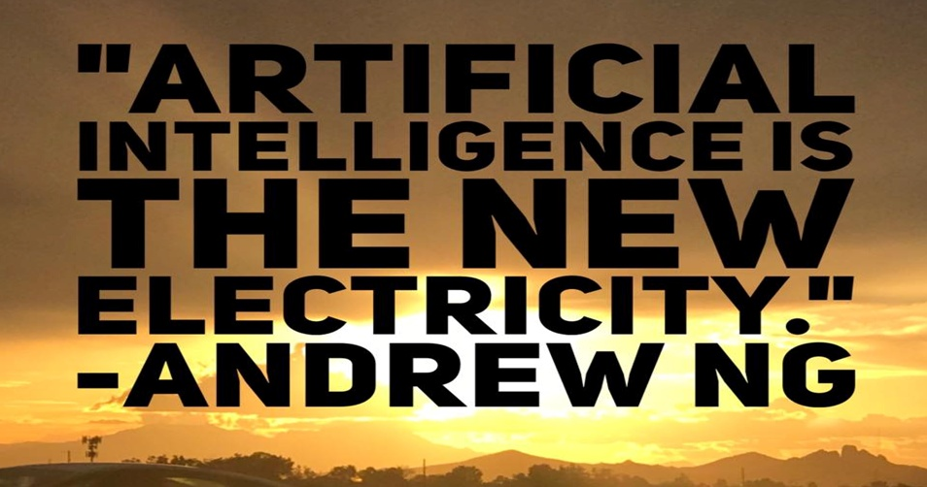
AI experts have become some of the most sought-after and well-paid employees in today’s tech economy.

Slide 36
Andrew Ng:
The core of deep learning is that we now have fast enough computers and enough data to actually train large neural networks.
very large neural networks we can now have and … huge amounts of data that we have access to
most flavors of the old generations of learning algorithms … performance will plateau. … deep learning … is the first class of algorithms … that is scalable. … performance just keeps getting better as you feed them more data

Slide 37
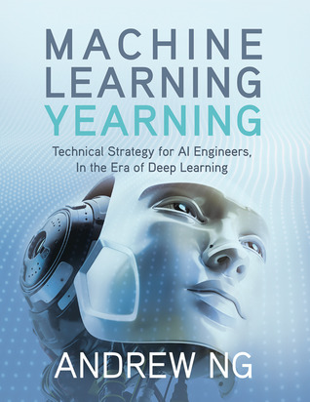
A free ebook from Andrew Ng, teaches you how to structure Machine Learning projects.
This book is focused not on teaching you ML algorithms, but on how to make ML algorithms work.

Slide 38
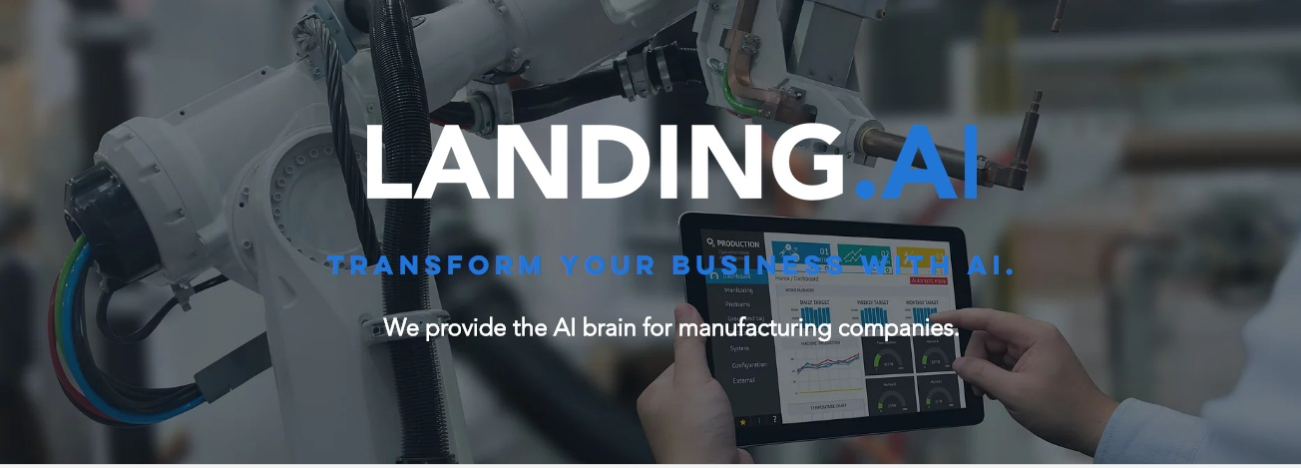
In Dec 2017, Ng announced Landing.ai, which is designed to accelerate AI’s implementation in manufacturing.

Slide 39
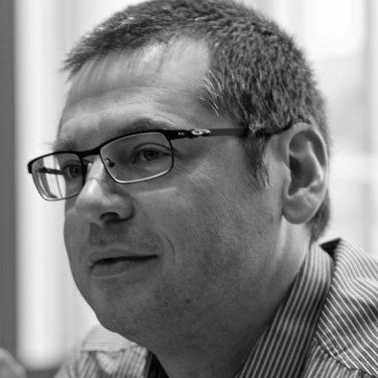
Aaron Courville
Department of Computer Science and Operations Research at the University of Montreal, and member of MILA (Montreal Institute for Learning Algorithms).
Research Interests : Machine learning, deep learning, probabilistic models and inference, neural networks, unsupervised learning, computer vision, artificial intelligence, models of cognition, perception and learning,

Slide 40
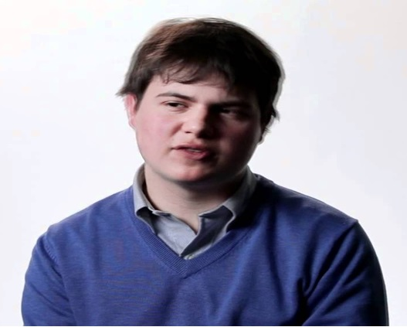
Christopher Olah, I do basic research in deep learning. I try to understand the inner workings of neural networks, among other projects. I also spend a lot of time thinking about how to explain them
Olah’s blog, colah.github.io, sets out to
“…understand things clearly and explain them well.”
The blog succeeds at efficiently explaining some of the most convoluted material in the field.
It also has some of the most beautiful machine learning diagrams on the web.

Slide 41
The Thiel Fellowship ( 20 under 20) is a fellowship created by Peter Thiel through the Thiel Foundation.
Peter Thiel co-founder of PayPal is one of the most venerated venture capitalists globally.
The fellowship offers a total of $100,000 over two years, as well as guidance and other resources, to pursue work, which could involve scientific research, creating a startup, or working on a social movement.

Slide 42
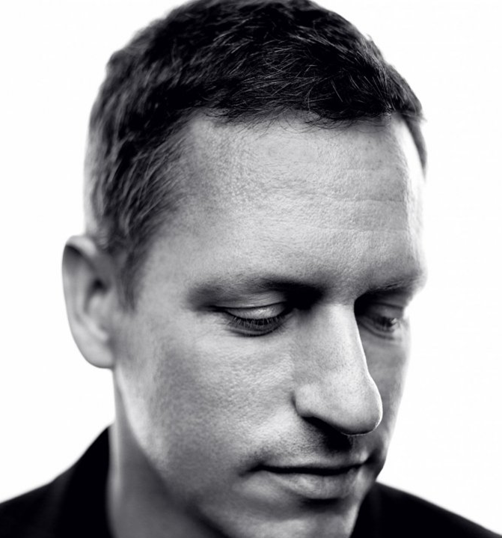
The Thiel Fellowship ( 20 under 20) is a fellowship created by Peter Thiel through the Thiel Foundation.
Thiel offers budding entrepreneurs the chance to win a $100,000 fellowship, if only they drop out of college.
The famous disruptor Peter Thiel says overpriced universities hold back innovation, and wants to rewire education to his liking.
Peter Thiel co-founder of PayPal is one of the most venerated venture capitalists globally.

Slide 43
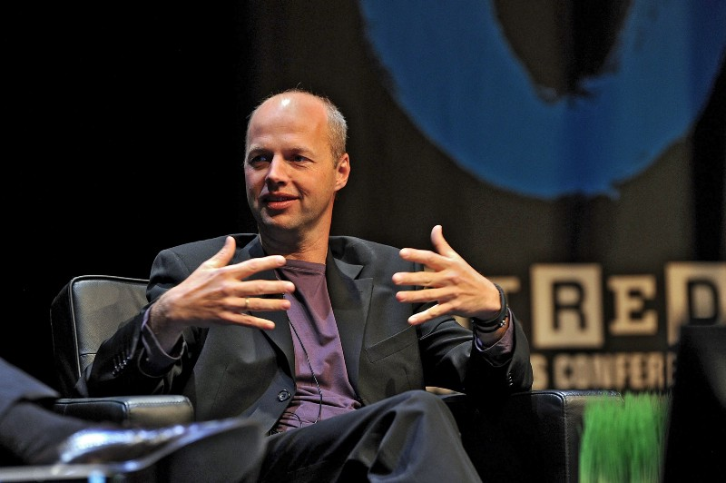
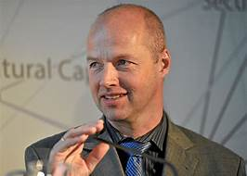
Sebastian Thrun, Udacity (@SebastianThrun) Similar to Andrew Ng, Sebastian Thrun is a Stanford Professor and is also co-founder and chairman of a MOOC, Udacity, whose mission is to democratize education by providing lifelong, on-demand learning to millions of students in more than 190 countries.
He is also the CEO of the Kitty Hawk Corporation, and founded Google X and Google’s self driving car team.
Udacity’s ML course is a tad more difficult than Coursera’s.

Slide 44

Kok-Leong Seow, Kseow.com has worked on creating quantum neural networks and is the creator of KSEOW.com, a leading website that teaches machine learning intuitively in
“tells a story”style
The purpose of this website is to introduce machine learning (ML) in an intuitive and "weird imagery/analogy” way with as little discomfort as possible

Slide 45

Andrej Karpathy director of AI at Tesla.
Andrej’s blog, karpathy.github.i0, provides good insights on niche subjects in machine learning.

Slide 46
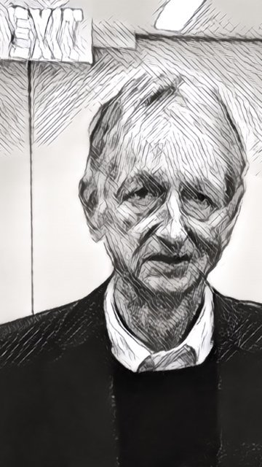
Semantic Scholar, one of the researchers who introduced the back-propagation algorithm and the first to use BPA for learning word embeddings(numerical representations of texts so that computers may handle them).
Rectified linear unit (ReLU), -Currently the most popular activation function for neural networks was first proposed for restricted Boltzmann machines (Nair & Hinton, 2010)
His other contributions to neural network research include Boltzmann machines, distributed representations, time-delay neural nets, mixtures of experts, products of experts, variational learning, and deep belief nets(DBNs).
Geoffrey E. Hinton- Godfather of AI
Google, University of Toronto

Slide 47
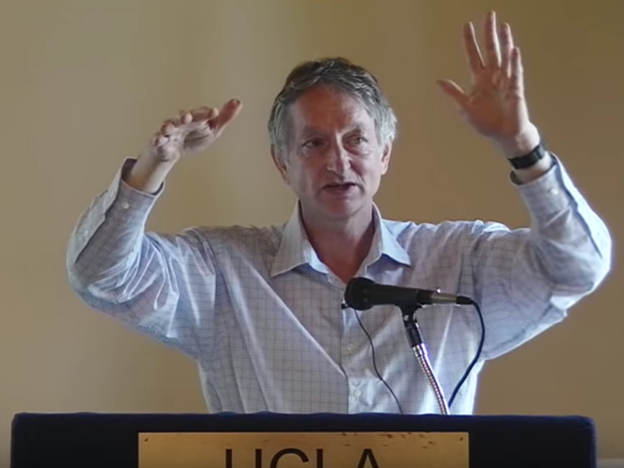
His other contributions to neural network research include Boltzmann machines, distributed representations, time-delay neural nets, mixtures of experts, products of experts, variational learning, and deep belief nets(DBNs).
His research group in Toronto University made major breakthroughs in deep learning that have revolutionized speech recognition and object classification.

Slide 48
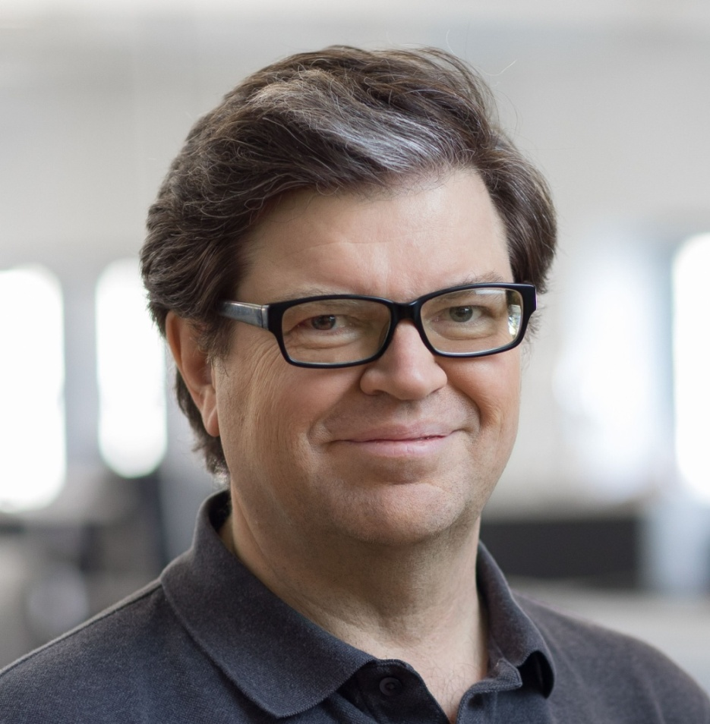
Yann LeCun,
Director of AI Research at Facebook and
Professor at NYU
In 1995, Yann LeCun and Yoshua Bengio introduced the concept of convolutional neural networks– a type of ANN which helps in extremely precise image recognition.
“Our intelligence is what makes us human, and AI is an extension of that quality.“ Dr. Yann Lecun, Professor, New York University
He was a postdoctoral research associate in Geoffrey Hinton's lab at the University of Toronto from 1987-88.

Slide 49
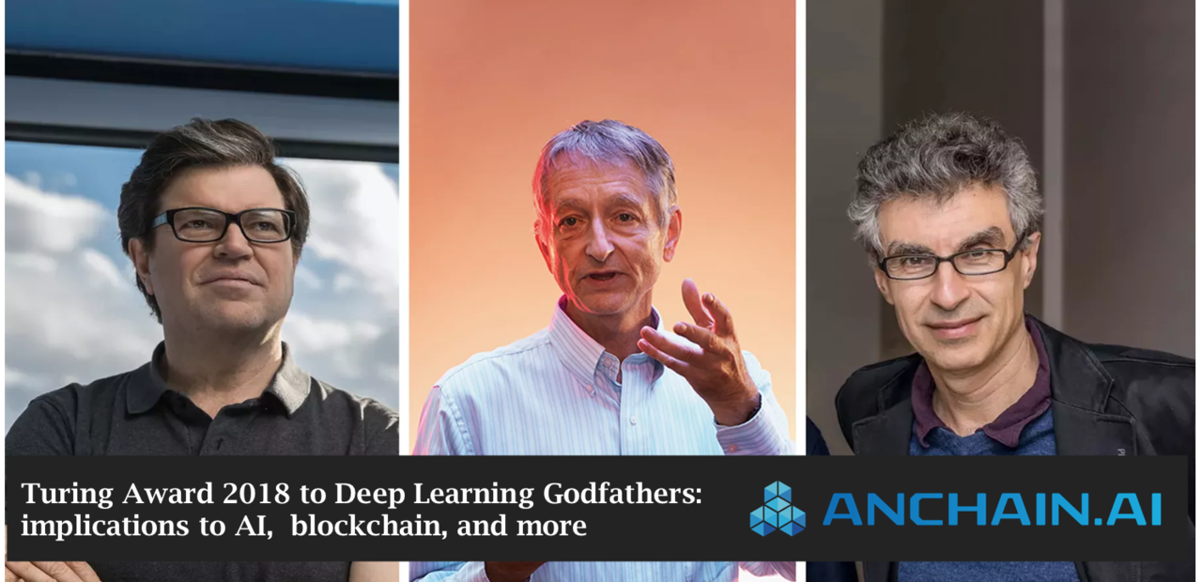
ACM named Yoshua Bengio, Geoffrey Hinton, and Yann LeCun as recipients of the 2018 ACM A.M. Turing Award, referred to as the “Nobel Prize of Computing,” carries a $1 million prize, with financial support provided by Google, Inc.

Slide 50
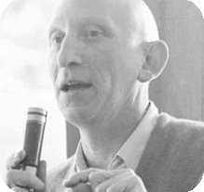
A.M. Turing Award is an annual prize given by the Association for Computing Machinery (ACM), Recognized as the highest distinction in computer science and the
Nobel Prize of computing.
First award :1966
First Turing Award to Alan J Perlis, United States – 1966
CITATION For his influence in the area of advanced programming techniques and compiler construction.

Slide 51
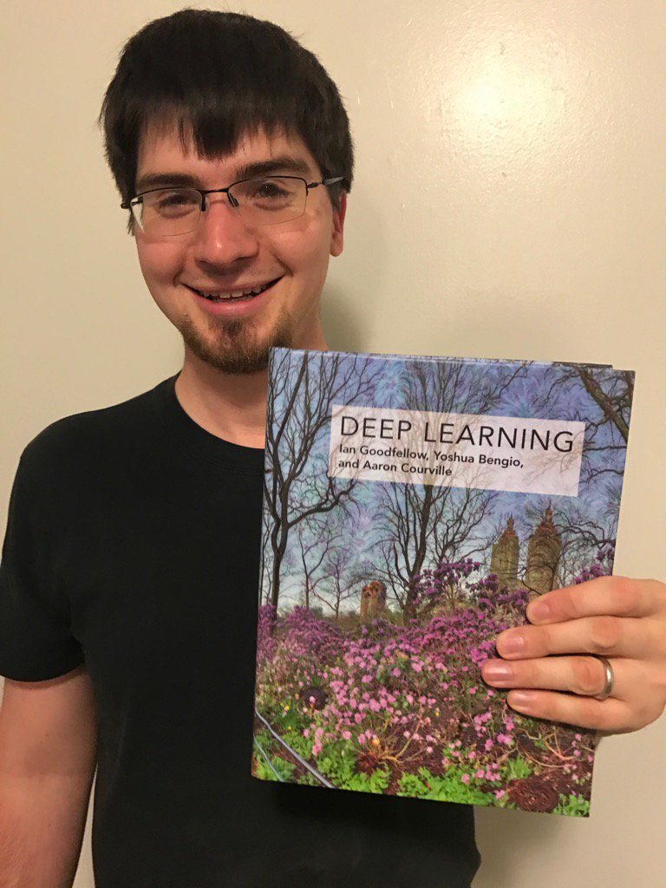
Ian Goodfellow
Institutions : Google Brain OpenAI, Now in Google Research
Doctoral Advisor : Yoshua Bengio Aaron Courville PhD in machine learning, University of Montreal, 2014 He invented Generative Adversarial Networks(GANs)

Slide 52
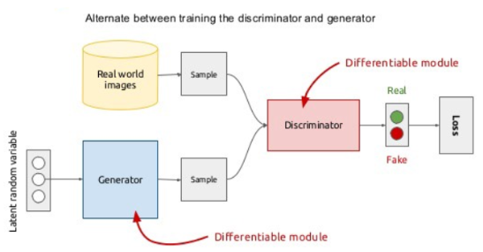

Slide 53
The Losses in these neural networks are primarily a function of how the other network performs:
Discriminator network loss is a function of generator network quality - Discriminator Loss is high for the discriminator if it gets fooled by the generator’s fake images
Generator network loss is a function of discriminator network quality — Generator Loss is high if the generator is not able to fool the discriminator.

Slide 54
In the training phase, Discriminator and Generator networks are trained sequentially intending to improve both the Discriminator and Generator performance.
The objective is to end up with weights that help Generators to generate realistic looking images.
In the end, we can use the Generator Neural network to generate fake images from Random Noise.

Slide 55
Hardware for Machine Learning - a New Type of Challenge for Processing

Slide 56
Deep learning involves huge amount of matrix multiplications and other operations
which can be massively parallelized and can be sped up on GPUs which are optimized for matrix calculations resulting in faster training with the order that is 50 times faster
Modern GPUs are very efficient at manipulating computer graphics and image processing.
Key GPU manufacturers :
Nvidia (first GPU geForce256), AMD(advanced micro devies), Intel, Tesla, Amazon Web Services (AWS) etc.
best CPUs have about 50GB/s while the best GPUs have 750GB/s memory bandwidth (rate at which data can be read from or stored into a semiconductor memory by a processor)

Slide 57

CPU vs GPU
GPU: Can work with tons of data, like cargoship Ship can bring thousands of blocks in one call but cannot do much else.
CPU : Jet can bring one small block of cargo fast enough, but it takes weeks to carry thousands. CPUs extremely fast and flexible.
Each one is good for its own tasks, but not efficient for others.

Slide 58
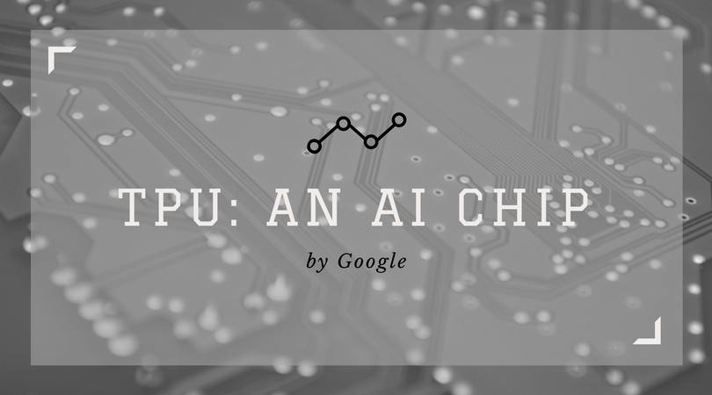
A Tensor Processing Unit (TPU) is an AI accelerator application-specific integrated circuit (ASIC) developed by Google specifically for neural network machine learning.
Compared to a graphics processing unit, it is designed for a high volume of low precision computation (e.g. as little as 8-bit precision)

Slide 59
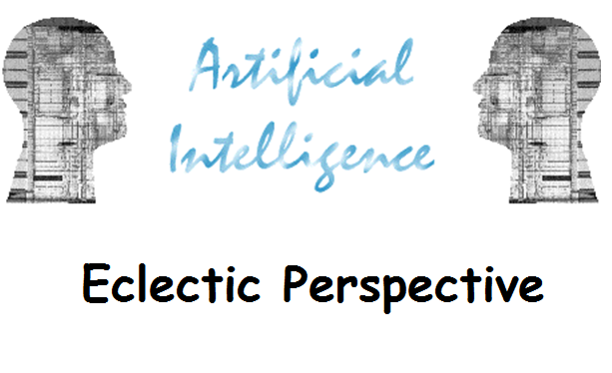

Slide 60
AI has become an essential part of the technology industry.
every customer interaction, every product, and every service offering will be touched and improved by AI in future.
Most AI examples rely heavily on deep learning and natural language processing(NLP).
80 percent of all applications will have an AI component by 2020”

Slide 61
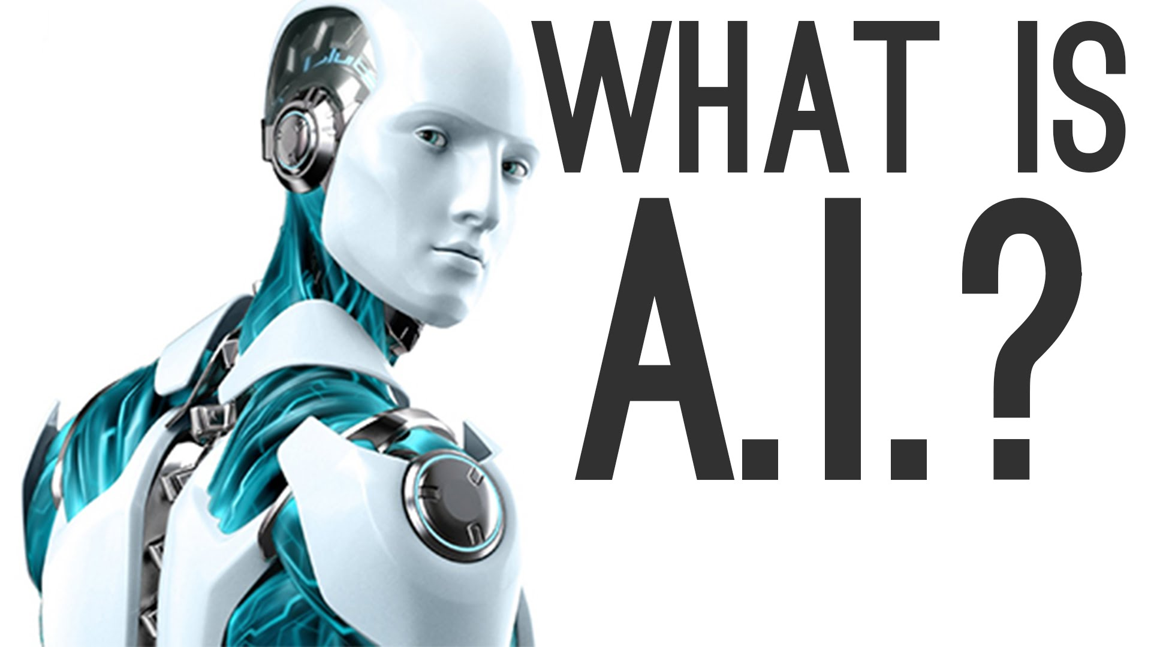

Slide 62
AI makes it possible for machines to learn from experience, adjust to new inputs and perform human-like tasks.
Using these technologies, computers can be trained to accomplish specific tasks by processing large amounts of data and recognizing patterns in the data.
Artificial intelligence is only a broader term that describes applications when a machine mimics “ cognitive “ functions that humans associate with human minds, such as “learning” and “problem-solving”.

Slide 63
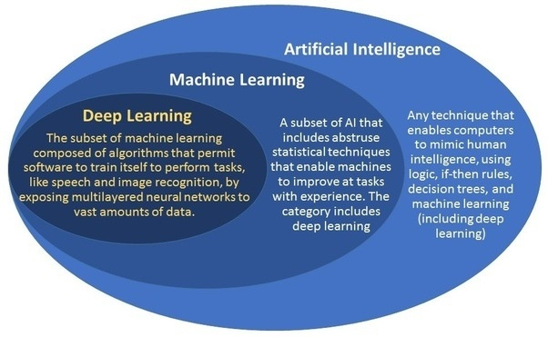

Slide 64
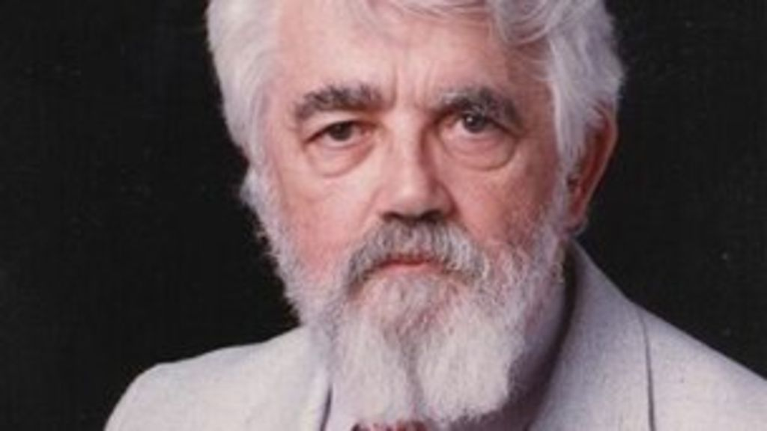
ARTIFICIAL INTELLIGENCE was coined in 1956 by John McCarthy (1927 –2011)- an American computer scientist and cognitive scientist at MIT
McCarthy was one of the founders of the discipline of artificial intelligence.

Slide 65
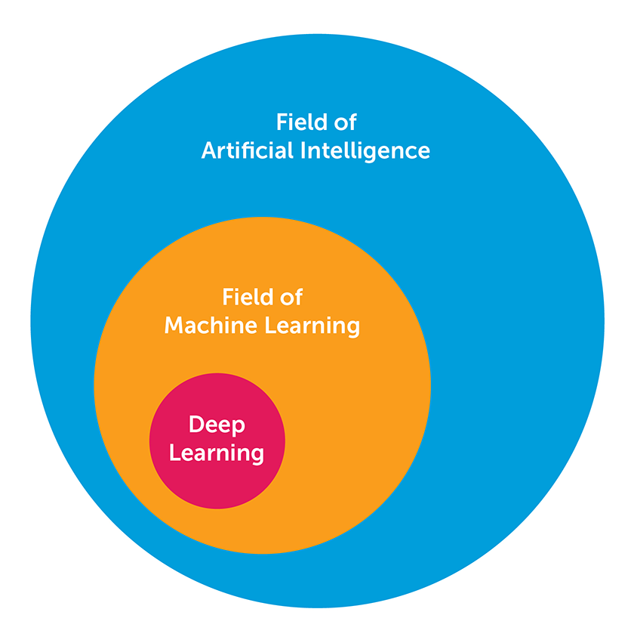

Slide 66
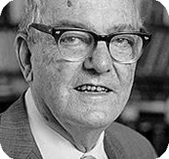
Herbert Alexander Simon (1916 –2001) was an American economist and political scientist whose primary interest was decision-making within organizations
Made contributions to artificial intelligence, the psychology of human cognition
HERBERT SIMON:
“LEARNING IS ANY PROCESS BY WHICH A SYSTEM IMPROVES PERFORMANCE FROM EXPERIENCE.”

Slide 67
"AI can have two purposes. One is to use the power of computers to augment human thinking, just as we use motors to augment human or horse power.
Robotics and expert systems are major branches of that.
The other is to use a computer's artificial intelligence to understand how humans think in a humanoid way.
If you test your programs not merely by what they can accomplish, but how they accomplish it, they you're really doing cognitive science; you're using AI to understand the human mind."
- Herb Simon ( 1961-2001)
Turing Award 1975
Nobel Prize in Economics 1978

Slide 68
Main difference between AI and conventional programming :
Non-AI programs are carried out by a set of defined instructions.
AI learns without being explicitly programmed.

Slide 69
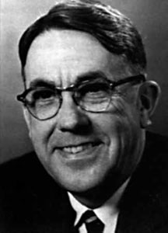
What is Machine Learning ??
Machine learning was a term coined by Arthur Lee Samuel - an American pioneer in the field of computer gaming and artificial intelligence
the term Machine learning in 1959, was defined by him as:
“The ability to learn without being explicitly programmed.”

Slide 70
Machine learning is the study of computer algorithms that improve automatically through experience
ML explores the study and construction of algorithms that can learn from and make predictions on data
Idea in ML is to get the algorithm to learn or be trained to do something without being specifically hardcoded.

Slide 71
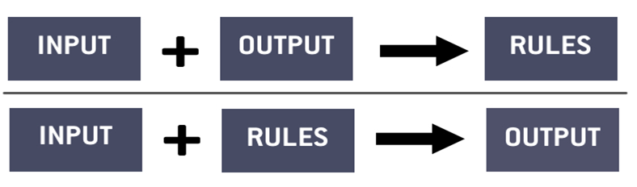
Is machine learning magic?
Could you use machine learning to solve any problem and get an answer as long as you have enough data.

Slide 72
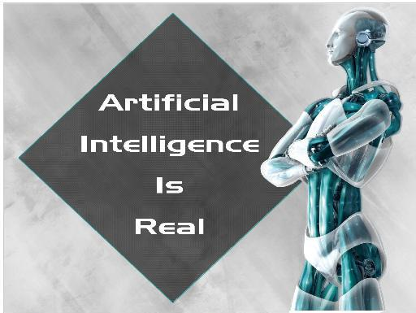

Slide 73
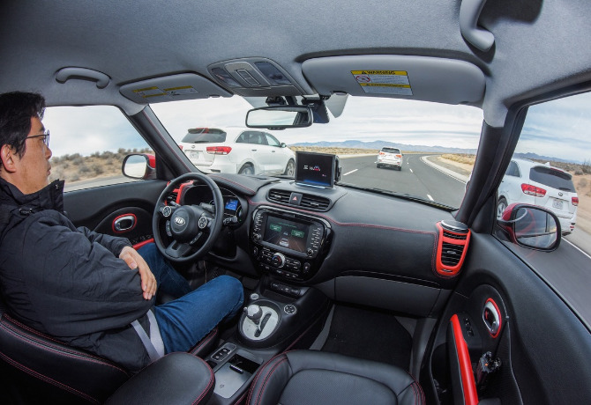
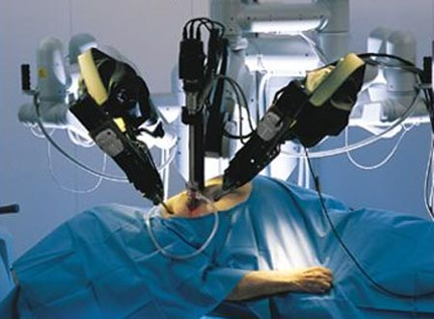
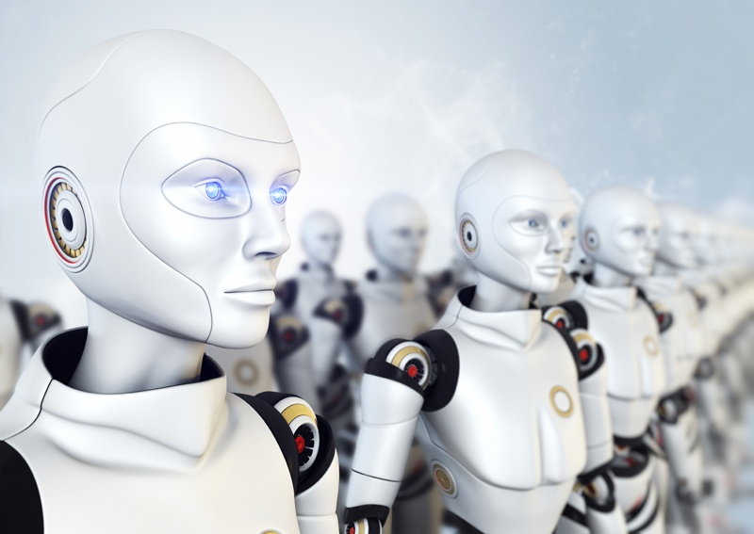
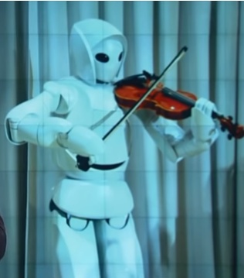

Slide 74

a computer program designed to simulate conversation with human users, especially over the Internet.

Slide 75
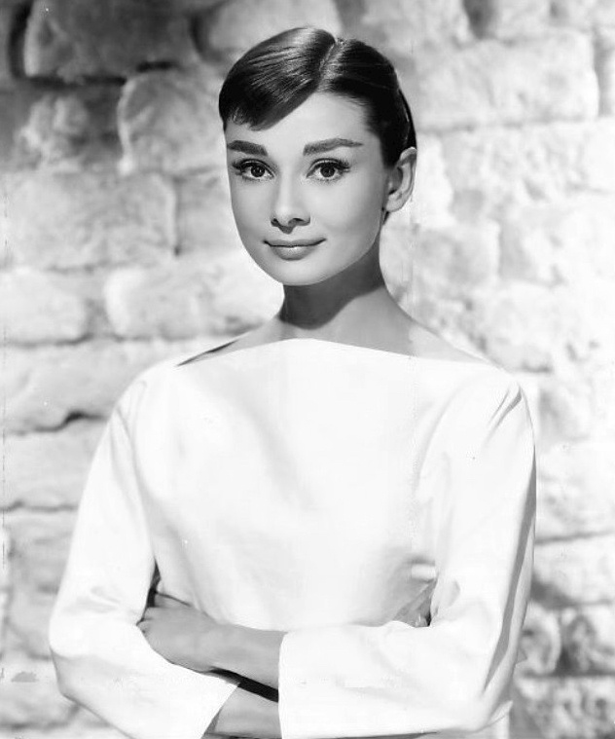
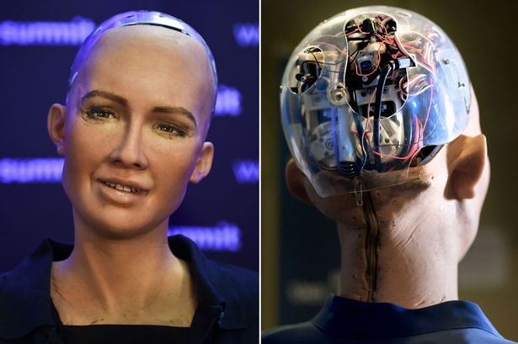
Known for its human-like appearance and behaviour, Sophia – a humanoid was developed by Hong Kong-based Hanson Robotics and activated in 2015.
Using AI, it imitates human gestures and facial expressions, and is able to make conversation on predefined topics.
The robot was granted citizenship of Saudi Arabia in October 2017.

Slide 76
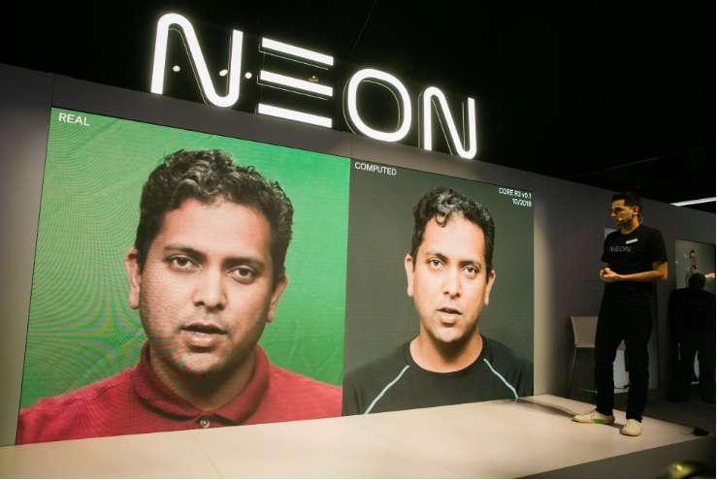
Neon CEO Pranav Mistry introduces the company's new AI to an audience at CES(Consumer Electronic Show) 2020 at Las Vegas.

Slide 77
WHY AI IS BECOMING AN IMPORTANT EMERGING TECHNOLOGY?

Slide 78
Computer systems shrinking in size and cost, blowing up in memory, speed and reliability .
"In knowledge lies the power", knowledge and skill are increasingly being considered as an asset
Complexity of knowledge is increasing exponentially while the current human knowledge and skills are not increasing at the same rate.
Needs for higher productivity, efficiency, greater flexibility and demand for lower costs

Slide 79
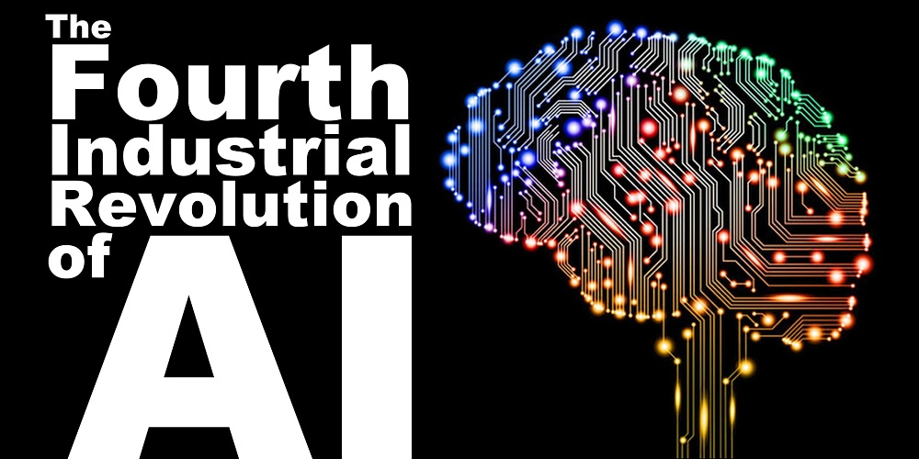
thought-provoking Quotes, insights about
What were first three revolutions ??

Slide 80
Thought-provoking Quotes, insights
about AI

Slide 81
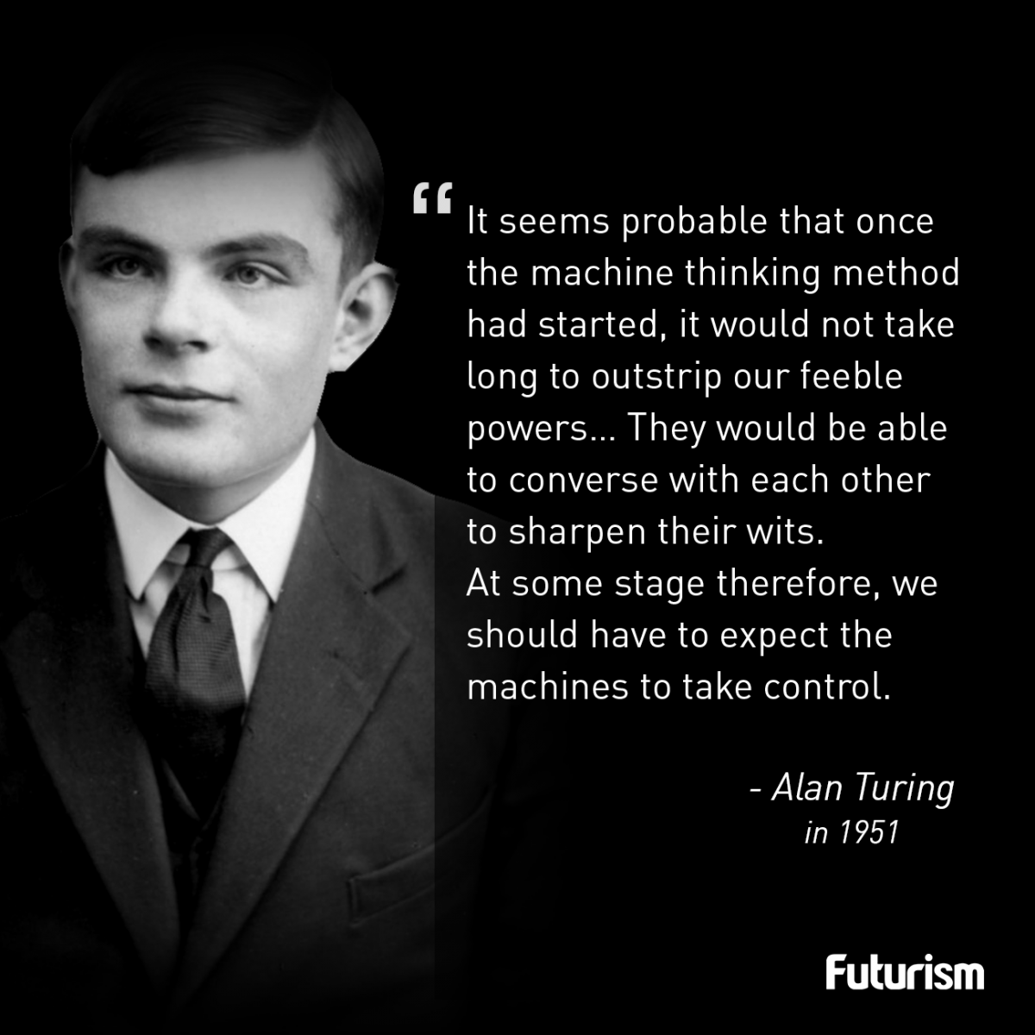

Slide 82
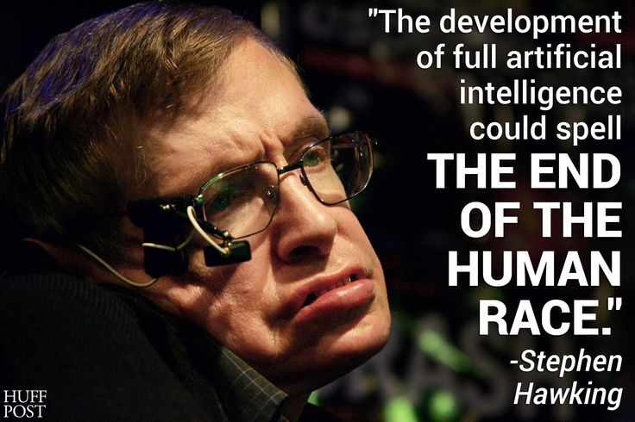

Slide 83
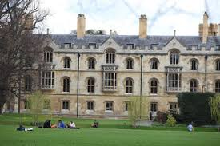
The Leverhulme Centre of the Future of Intelligence at the University of Cambridge, where Stephan Hawking was also a professor, has received more than US$12 million (£10 million) in grants to run research projects that will enhance the future potential of artificial intelligence, while carefully addressing the risks..
offers courses in subjects such as "Terminator Studies"

Slide 84
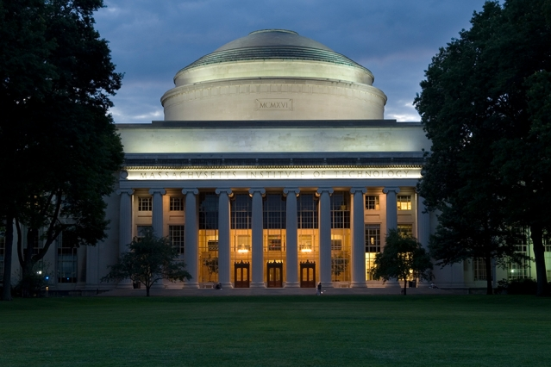
MIT reshapes itself to shape the future
Gift of $350 million establishes the MIT Stephen A. Schwarzman College of Computing, an unprecedented, $1 billion commitment to world-changing breakthroughs and their ethical application.

Slide 85
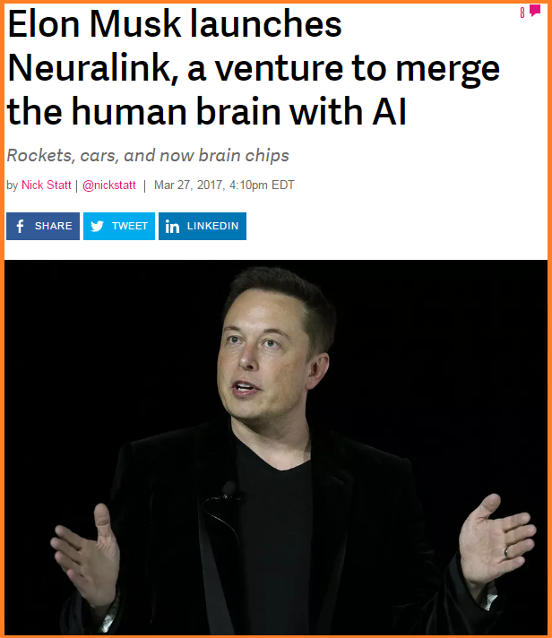

Slide 86
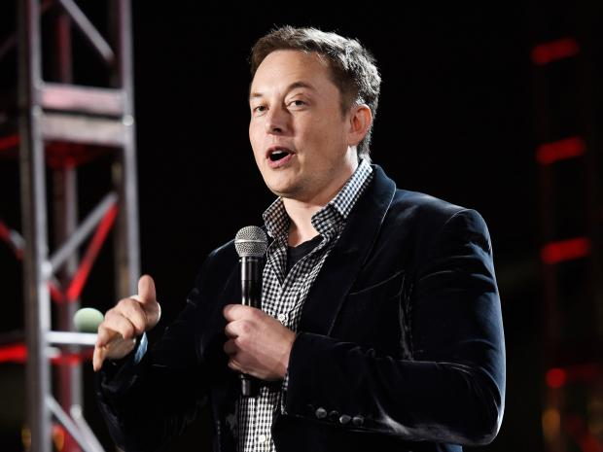
Addressing students at the Massachusetts Institute of Technology, Musk said: “I think we should be very careful about artificial intelligence. If I were to guess like what our biggest existential threat is, it’s probably that.

Slide 87
No matter how well the computer does its job, no matter how well it manages to store information, no matter how speedily and accurately it can recall that information, it will never be more than an assistant to the human science writer who is doing something we can't program the computer to do because we do not know how the human being does it, because the important thing is not simply to store data mechanically, not simply to recall it quickly and accurately, but to be able to tell when a story is important, to be able to know how to express it so that people understand it - in other words to know how to be a crackerjack science writer.
I think it is important not to worry about whether computers will replace us, but whether we can make computers even better at what they do - so that together, cooperatively, we can proceed much faster and much more effectively in elucidating the secrets of the universe than either type of intelligence can possibly do alone.
ISAAC ASIMOV
Crackerjack : exceptionally good

Slide 88
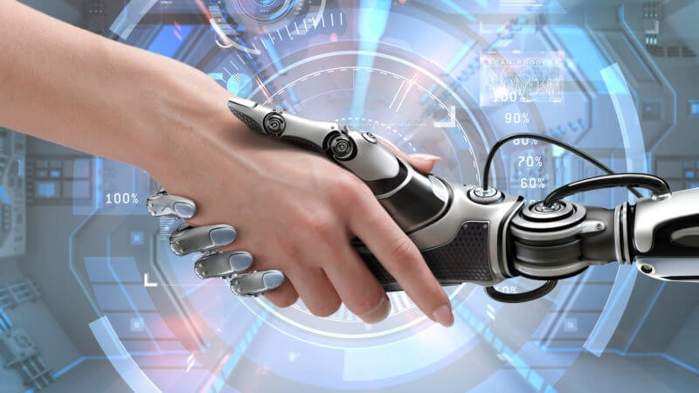


Slide 89
END

